Slide 1
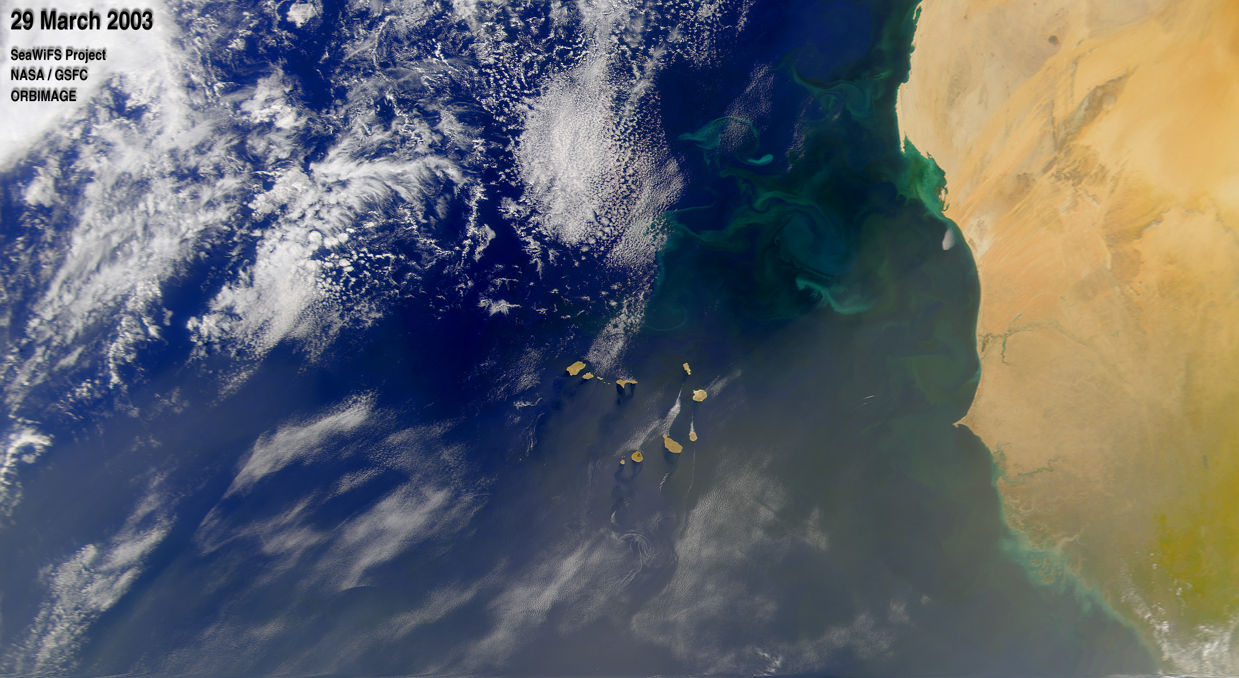
Phytoplankton health in Mauritania coast
Planktonic Pirates Team
Notes:
Today, our team “Planktonic Pirates” would like to present our investigation on the phytoplankton health in Mauritania coast.

Slide 2
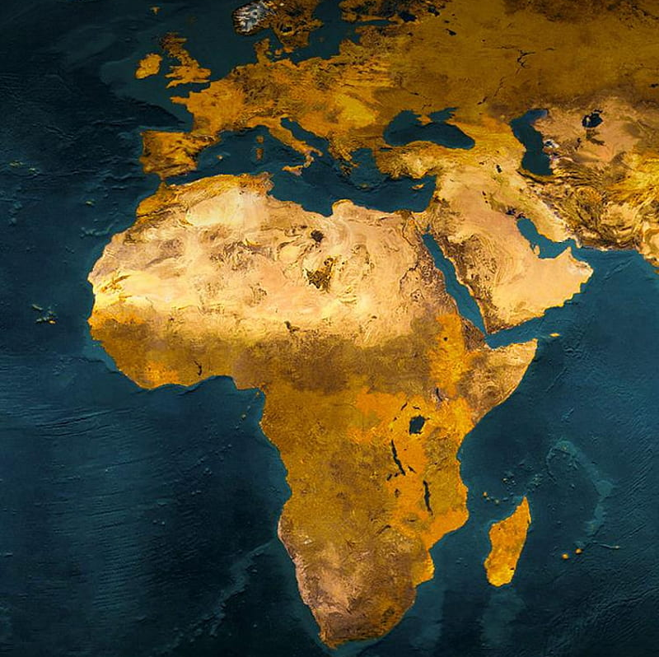
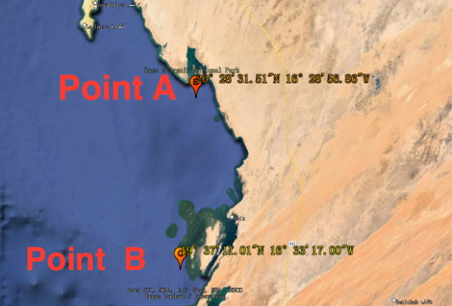
Mauritania coast
Help marine and human to sustain.
50% of oxygen for us to breathe.
Value of region:
High phytoplankton population
Political and economic status: Fishing industry in West Africa.
Our investigation method:
2 points on Mauritania coastline
3 key factors
Chlorophyll alpha signal
Pigment and green
Reflect phytoplankton biomass
Sea temperature
Warmer sea or colder sea
Net Primary Productivity (NPP)
Net rate of producing organic matters
Higher rate, more phytoplankton population
Source: (Gibbs, 1984; Winder et al, 2012; Petrovskii et al, 2017; Käse et al, 2018)
Notes:
1. Our team think that Mauritania coast has a great value to study the phytoplankton because of its high population of phytoplankton and good political and economic status.
2. Regarding our method, we selected 2 points near coast to monitor 3 key factors. 3. First, the chlorophyll alpha signal, which is color indicator found in the phytoplankton biomass.
4. Second, sea temperature, we would like know whether a warmer sea or colder sea is correlated to more phytoplankton.
6. Last, the Net Primary Productivity NPP , know the phytoplankton’s rate of producing organic matters after consuming organic matters during photosynthesis. With more rate, more phytoplankton population.

Slide 3
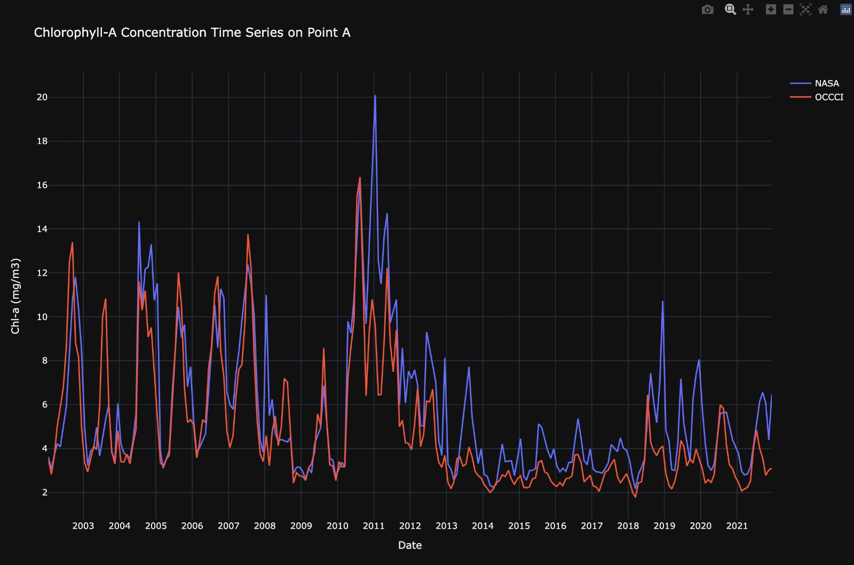
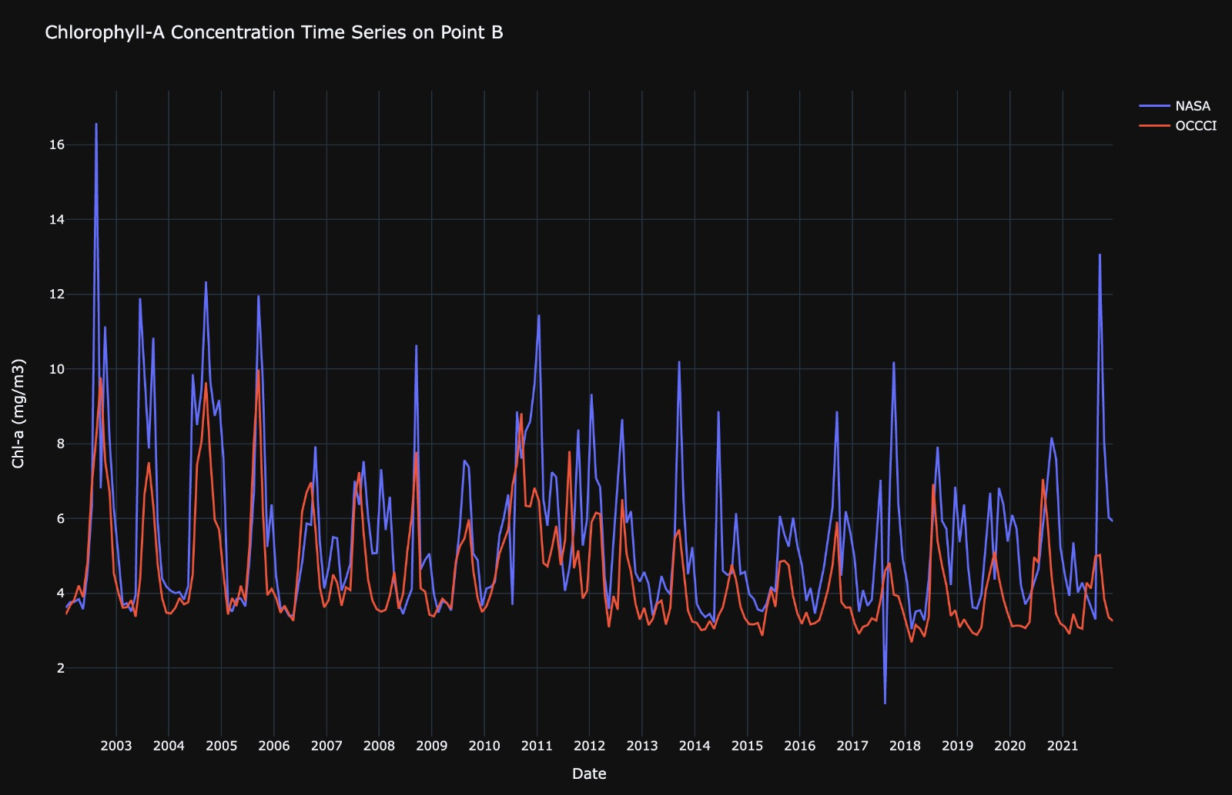
The data from both sources seems to be similar and converging.
Point B is not as interesting as point A to be explored further.
Notes:
NOTES: (don't forget that the sources are two different satelities and 2 method to calculated the chrolophill)
Chl-a concentration unit is milligrams per cubic metre.
From the two points selected we can see the concentration from 2 methods:
Sharp decrease in 2012 in point A
The point A region is capturing something special.

Slide 4
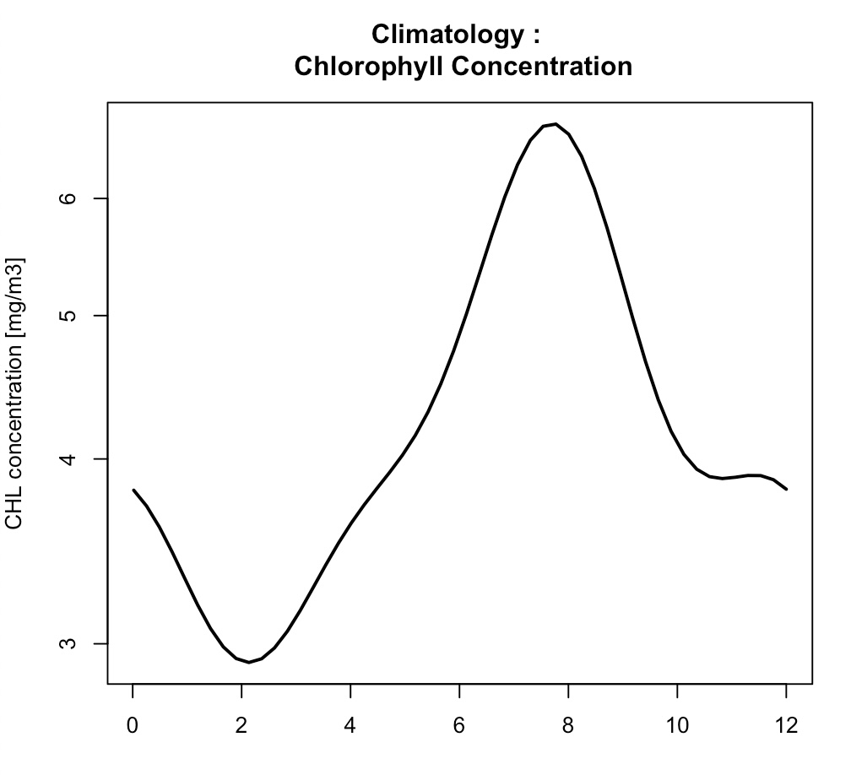
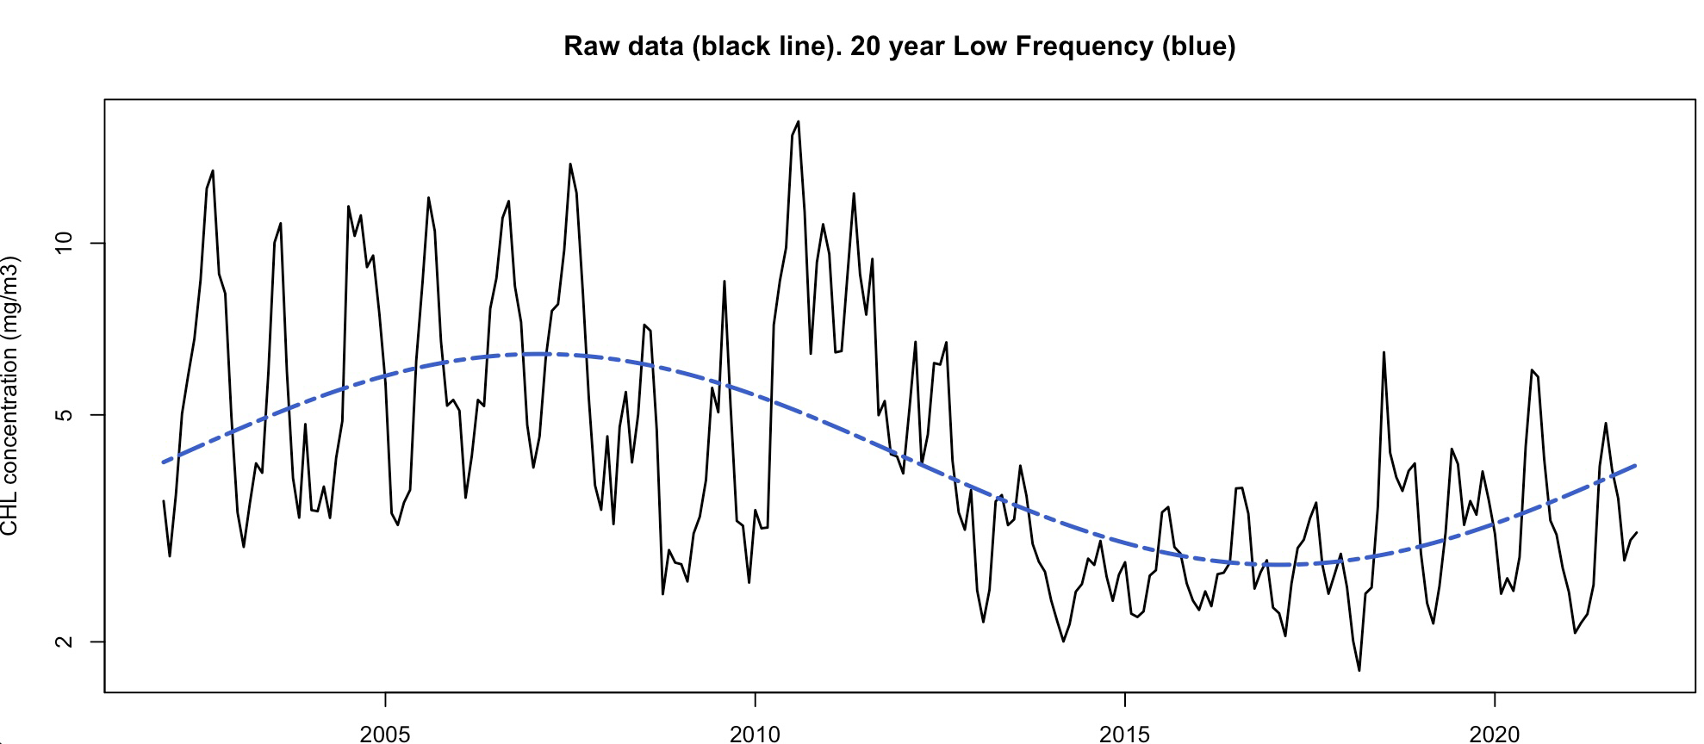
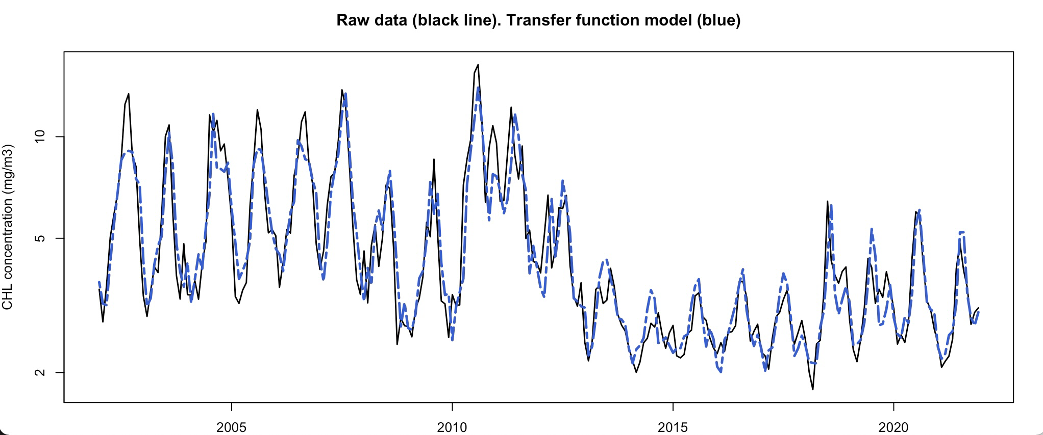
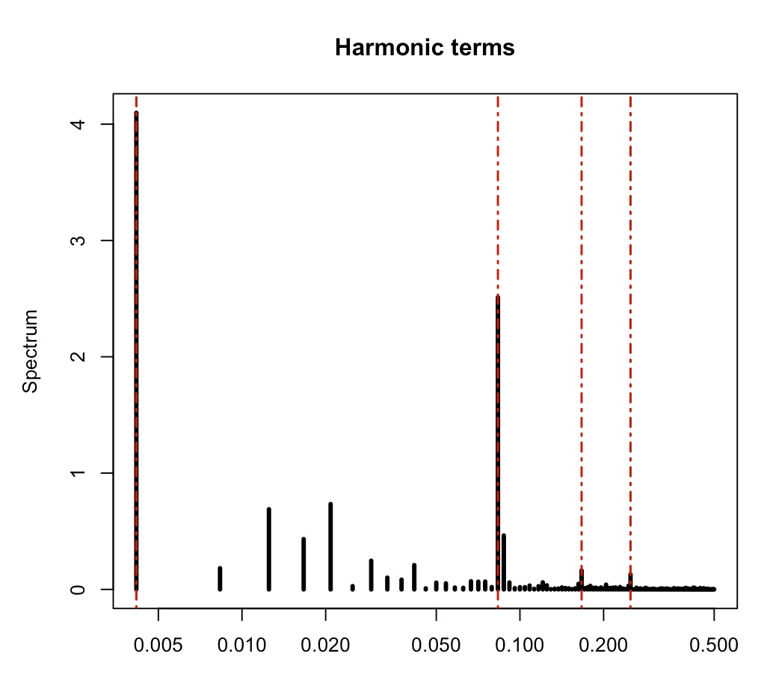
Chlorophyll-a Signal What happened in the last 20 years?
Annual mean chlorophyll-a cycle
Chlorophyll-a Dominant Frequency Model
Significant Harmonics in the chlorophyll-a signal
20 Year
1 Year
Significant serial correlation accommodated in the model
 | Coef | 95% CI
Auto correlation | 0.78 | 0.71-0.86
Model R² = 0.85
Notes:
Looking at the frequency spectrum, the first data point, representing the 20 year cycle have been determined to be statistically significant.
Now looking at the yearly peaks we can see that on average the chlorophyll production is at its maximum on august and at its minimum on January.
Raw data (black line) graph: so we have a warm phase present from 2002 to 2012 and on the second part of the cycle, we have a cold phase from 2013 to present day.
During the warm phase it can be see that during the peaks chlorophyll increases sharply. As we transition form the warm phase to the cold phase the bloom intensity gradually decreases. In the cold phase the peaks have the lowest chlorophyll production.

Slide 5
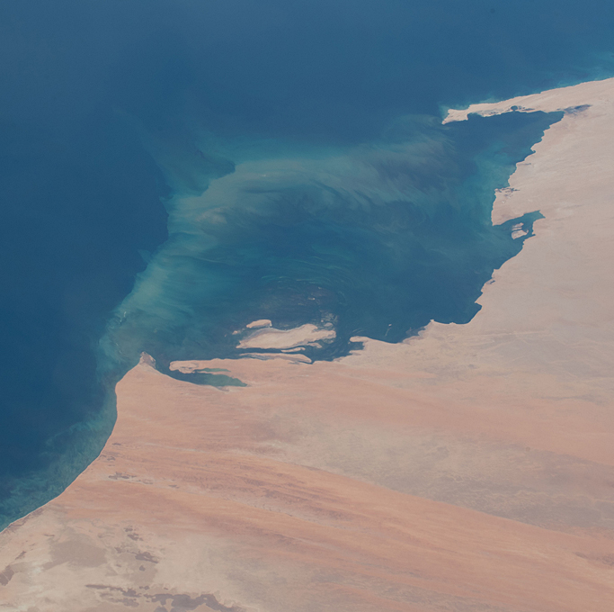
Dominant frequency analysis:
Significant 20-year cycle
Cyclical Atlantic changes
Sea surface temperature changes
Notes:
It is probable that this cycle is caused by the Atlantic multidecadal oscillation (AMO), which is a natural phenomena that causes changes in sea surface temperature that occur over periods of 20 years.
These sea surface temperature variation can change plankton nutrient circulation making them rise to the surface, reaching the plankton and increasing their reproduction in that phase.
This phenomenon explain our higher peaks at warm phase of the cycle and lower peaks at cool phase of the cycle.
But whether this longer term decadal variability is due to this natural phenomenon or global warming is up to debate.
To explain what are the underlying causes for this variation during the analysis period, we need more detailed data over a more extensive period.

Slide 6
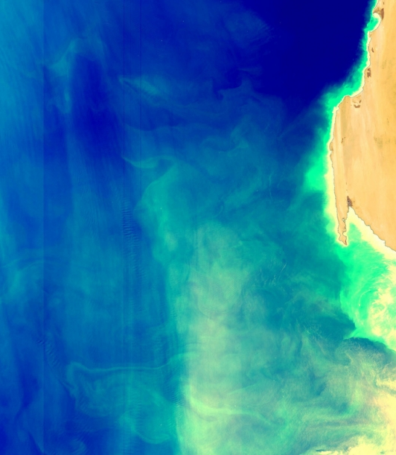
Further analysis
Climate change contribution through carbon absorption
High nutrient plankton-chlorophyll relation
Net primary product: plankton contributing in CO2 absorption
Notes:
In our research data, we cannot distinguish between the multiple species of plankton with the data currently available, this has the implication that we cannot derive the Net Primary Productivity(NPP) , which is the ratio of CO2 absorbed
High nutrient plankton have high concentration of chlorophyll
We wanted to see how much this area is contributing climate change by absorbing the carbon
Net primary product is tells you how much these plankton contributing to absorbs CO2. How much net carbon they absorbs after releasing their CO2

Slide 7
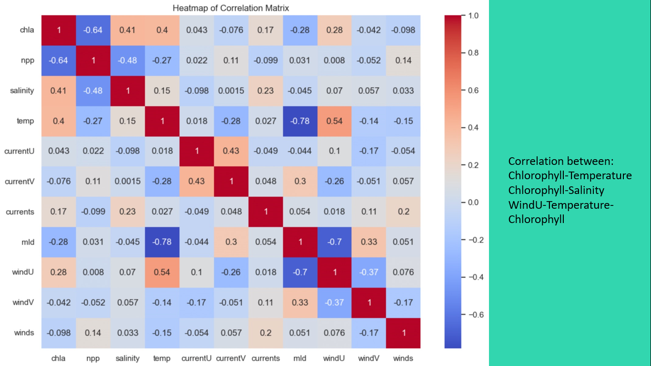
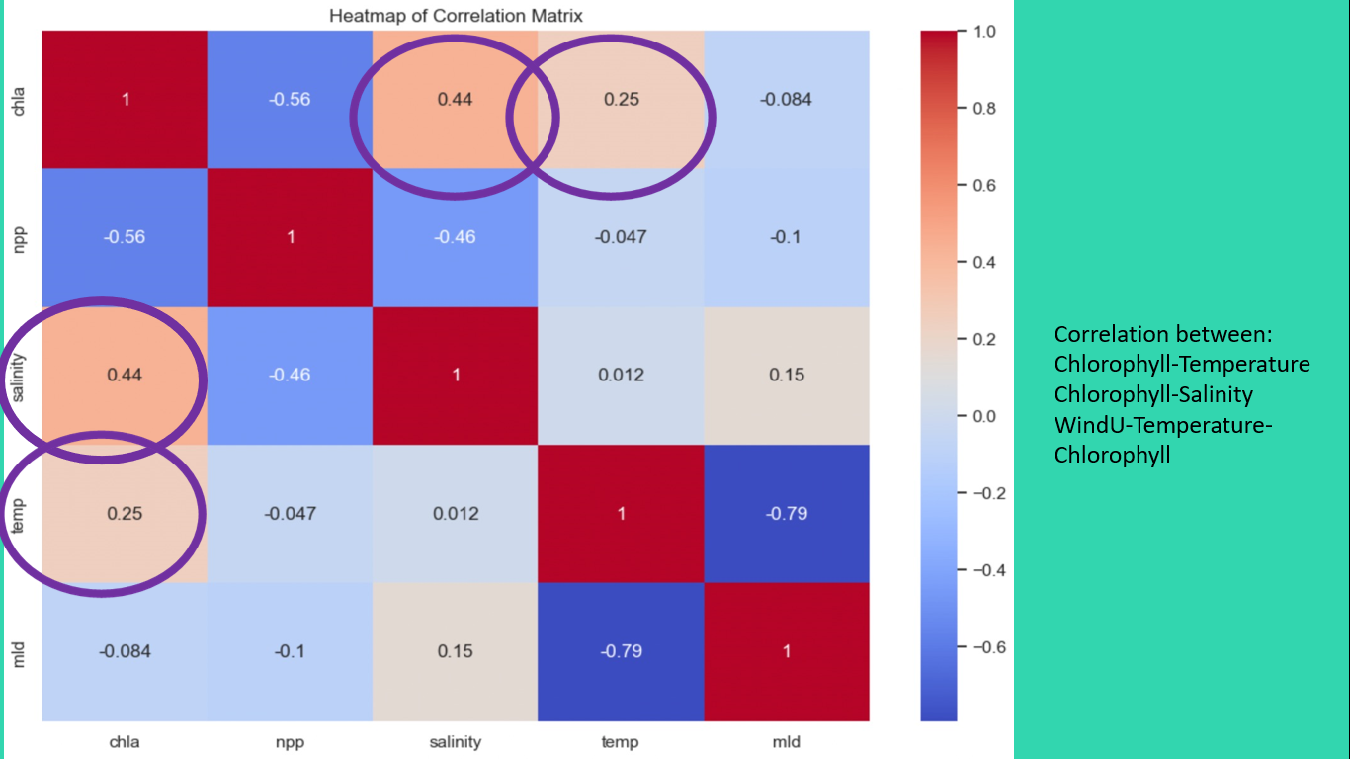
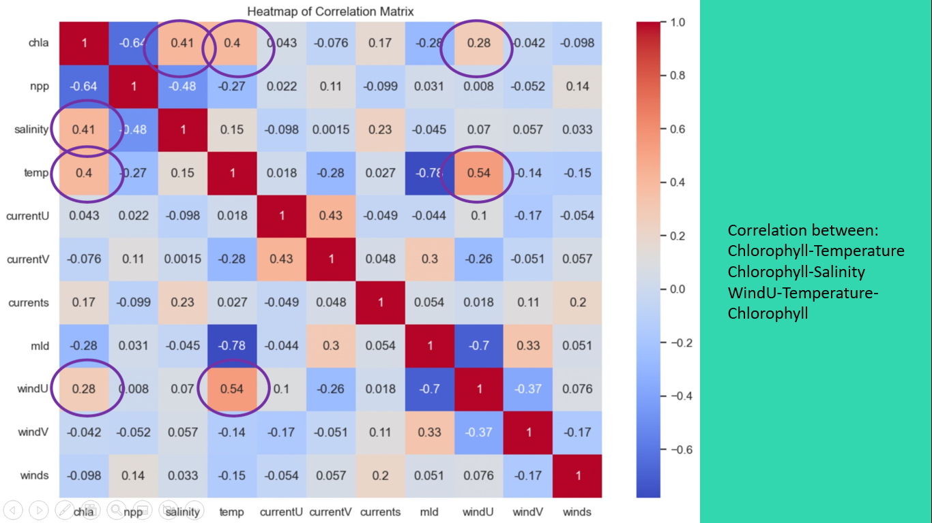
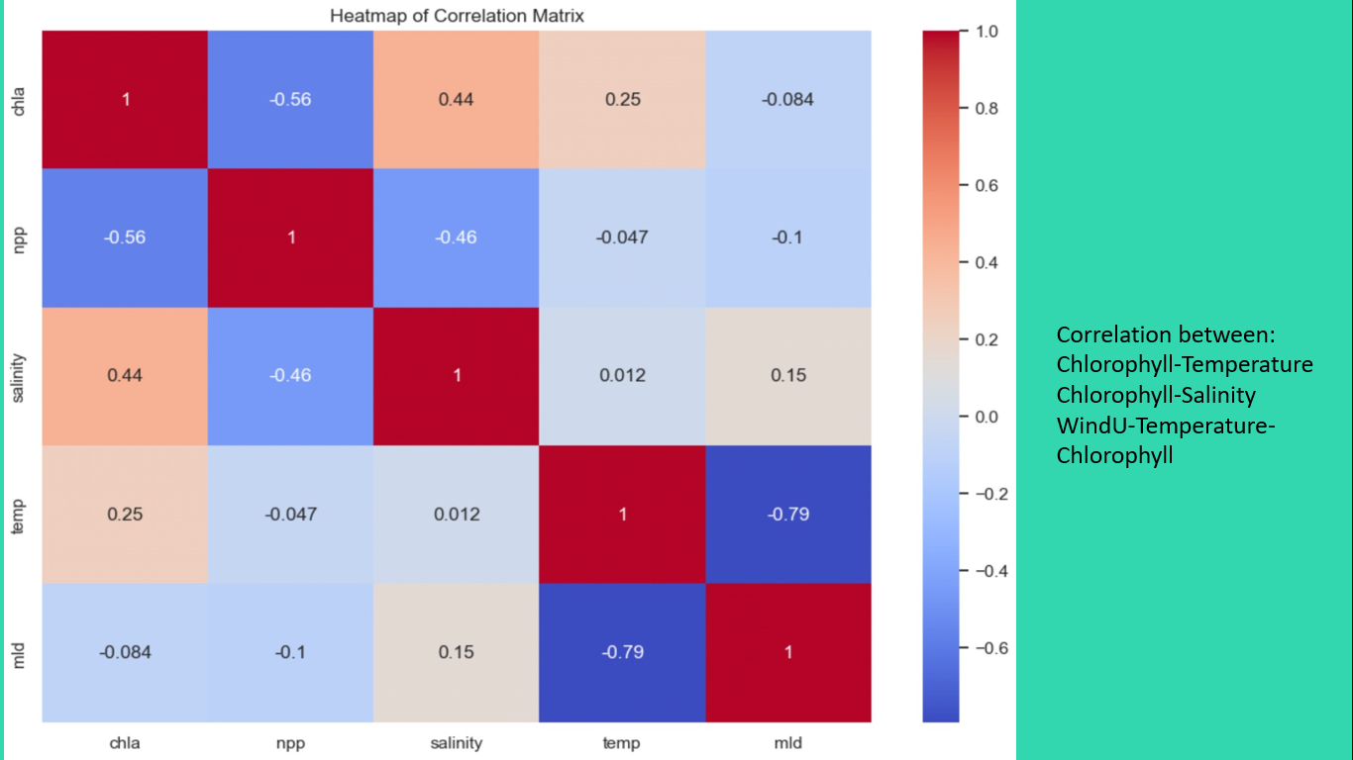
1998 – 2018 data in heatmap:
Salinity and Sea Surface Temps
1998 – 2014 data in heatmap: Indirect correlation of latitudinal wind with chl-a.
Notes:
Salinity and Temperature correlaitons.
Trading 4 years of data for more features – winds, currents
Identifying indirect horizontal wind correlation with chl-a via temps. Latitudinal winds could be due to Sahara.

Slide 8
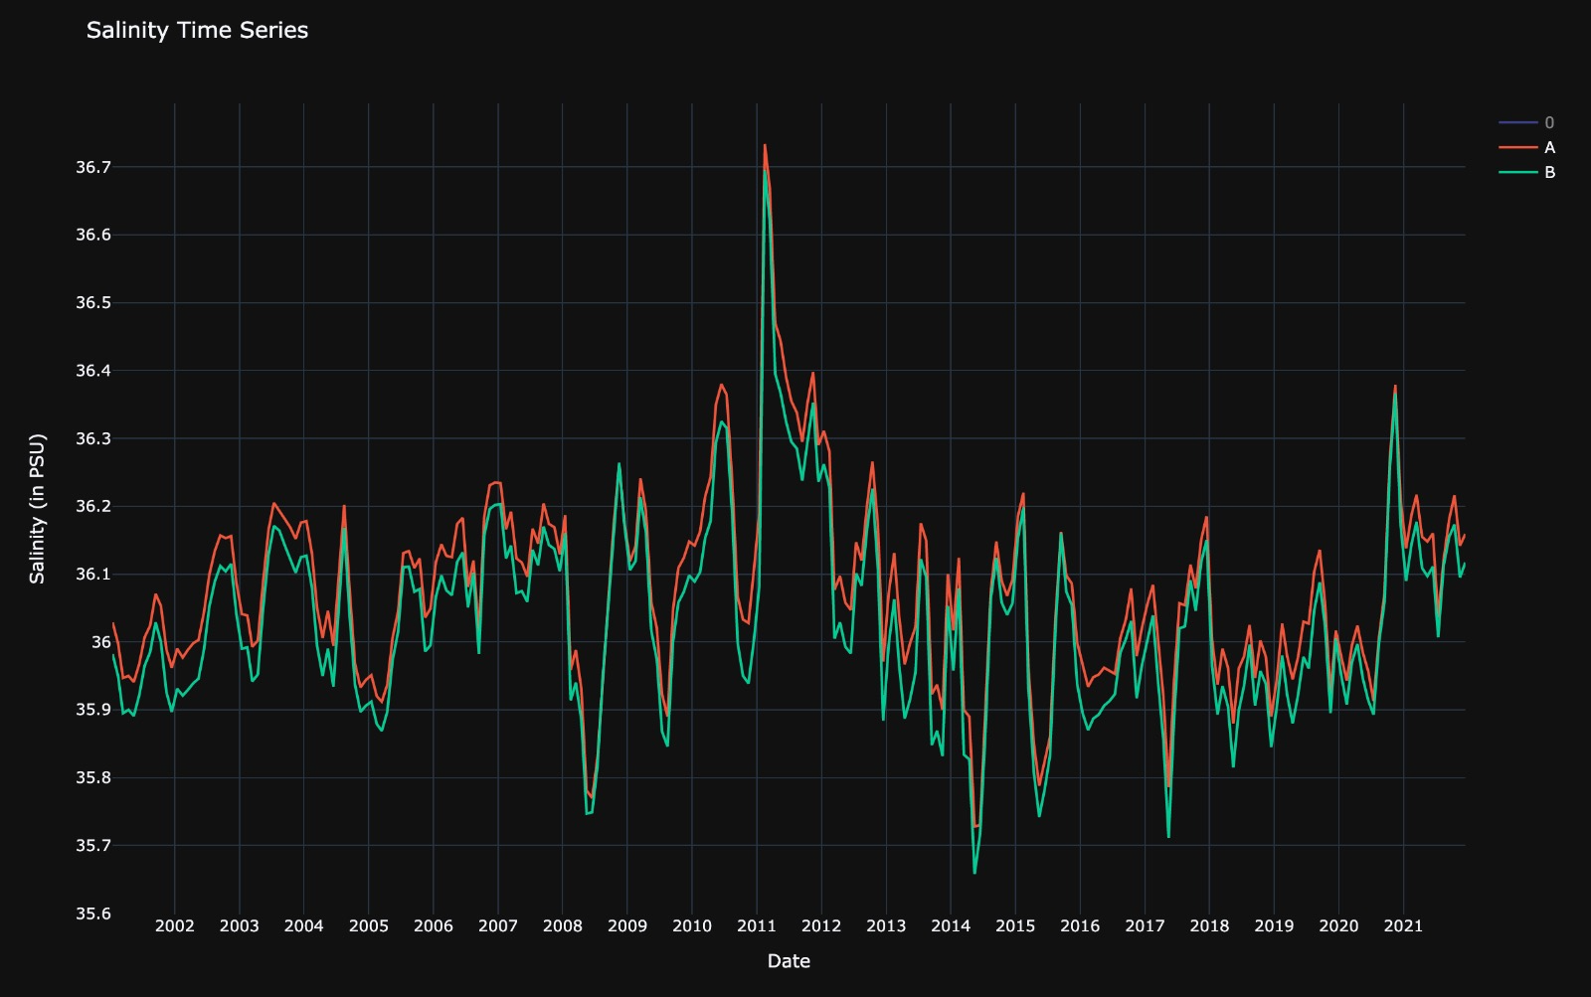
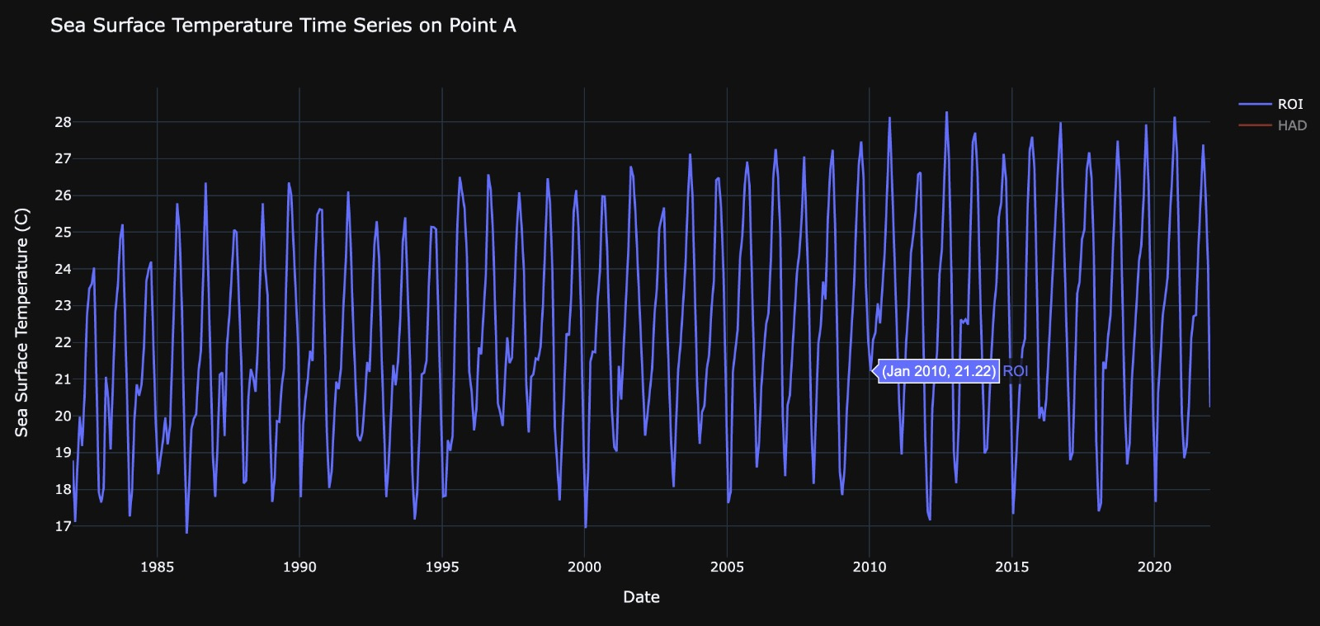
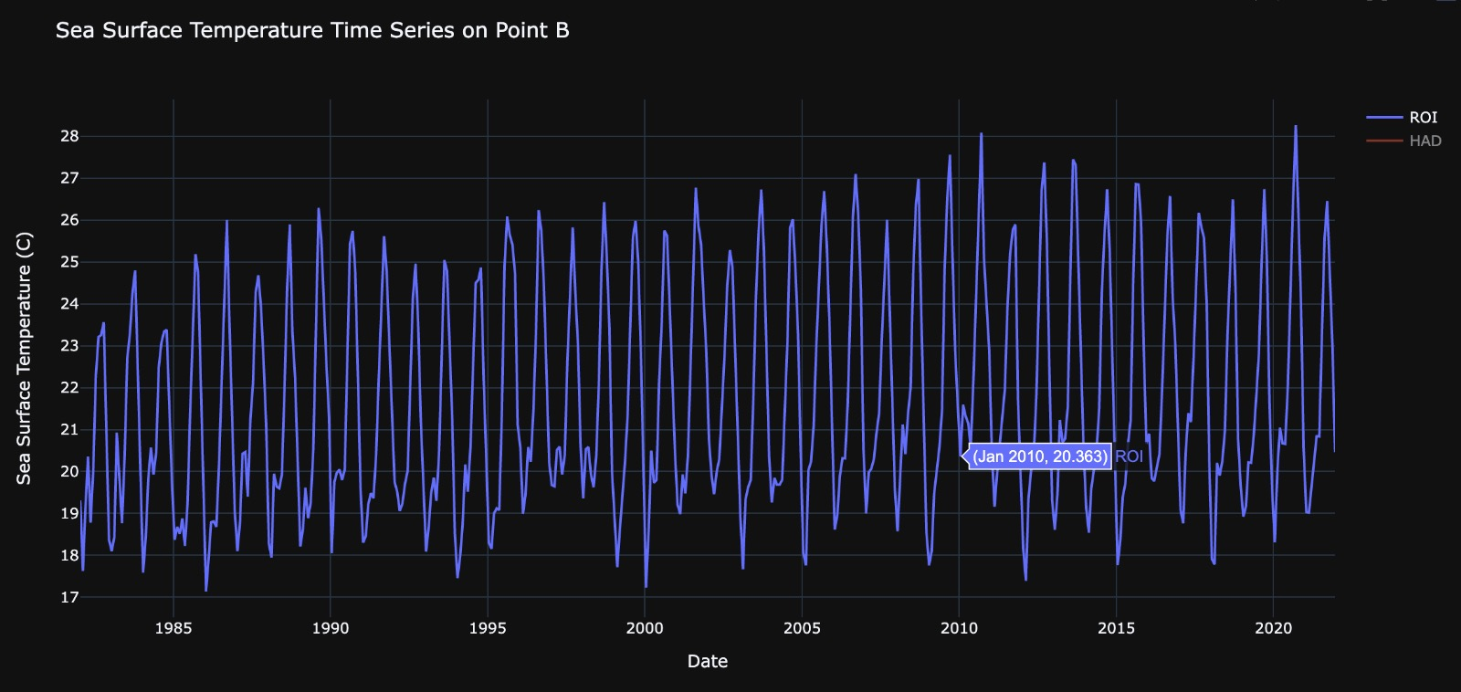
Salinity in water is measured at 5m depth
Both these regions became strong halocline areas between 2010-2012.
Sea surface temperature with increasing highs and lows. Peculiar high bottom at Jan 2010.
Notes:
Salinity can affect chl-a and NPP through its influence on water density, nutrient availability, and light penetration in the water column. In general, higher salinity waters tend to be denser than lower salinity waters. As a result, in areas where freshwater mixes with seawater, there can be a stratification of water layers with different salinities. This can impact chl-a and NPP because it affects the mixing of nutrients and light in the water column. In areas where there is a strong halocline, the layer of water with lower salinity can be nutrient-rich but light-limited, while the layer with higher salinity can be light-rich but nutrient-limited. This can impact the growth of phytoplankton, which is a key driver of chl-a and NPP.

Slide 9
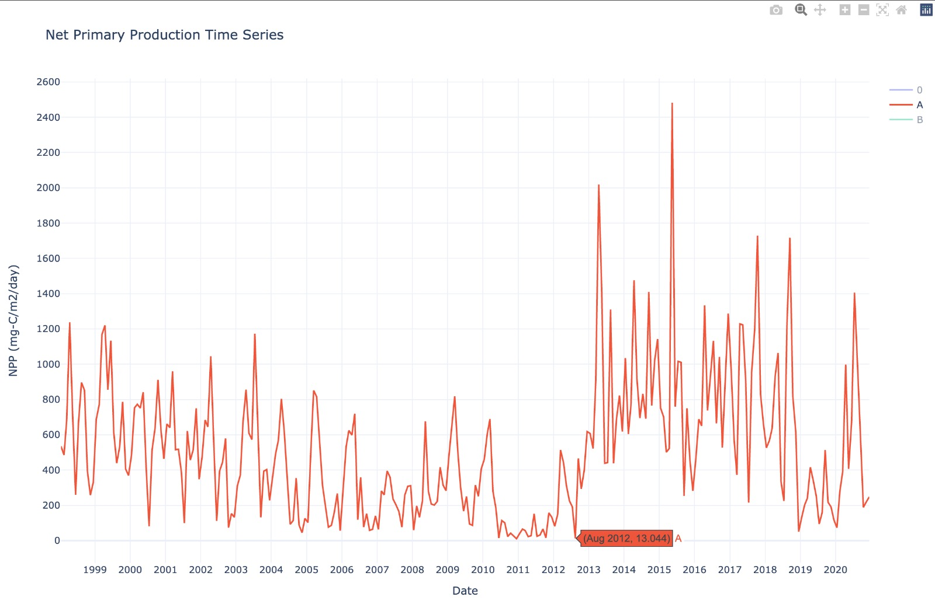
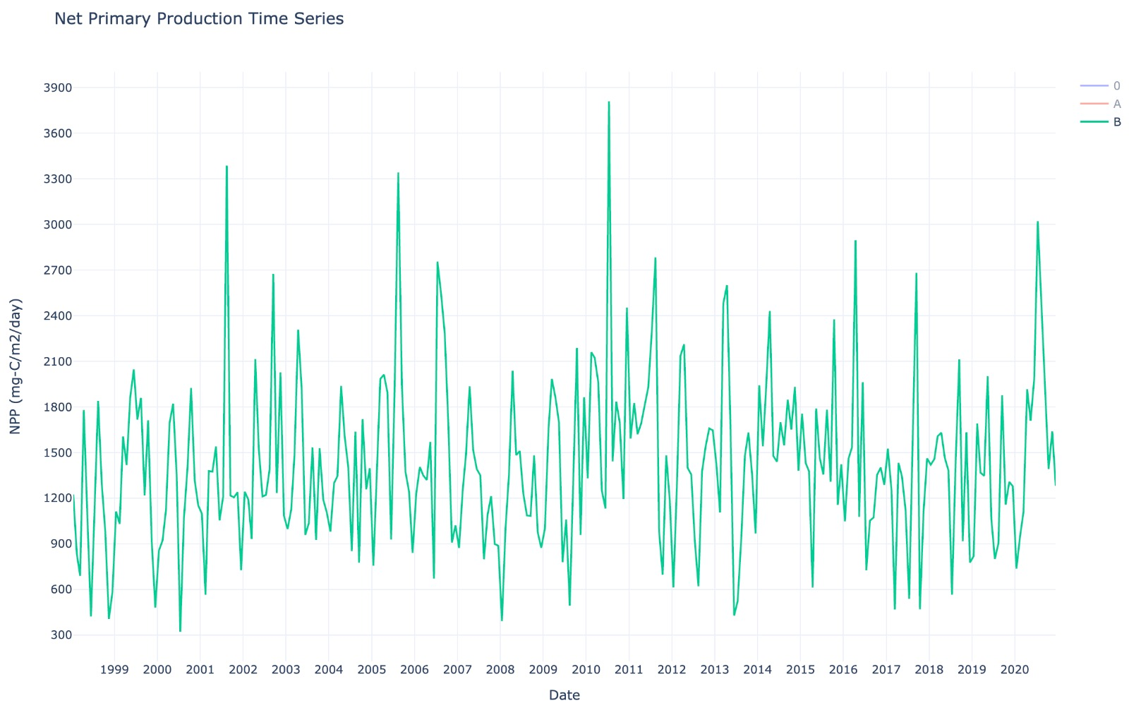
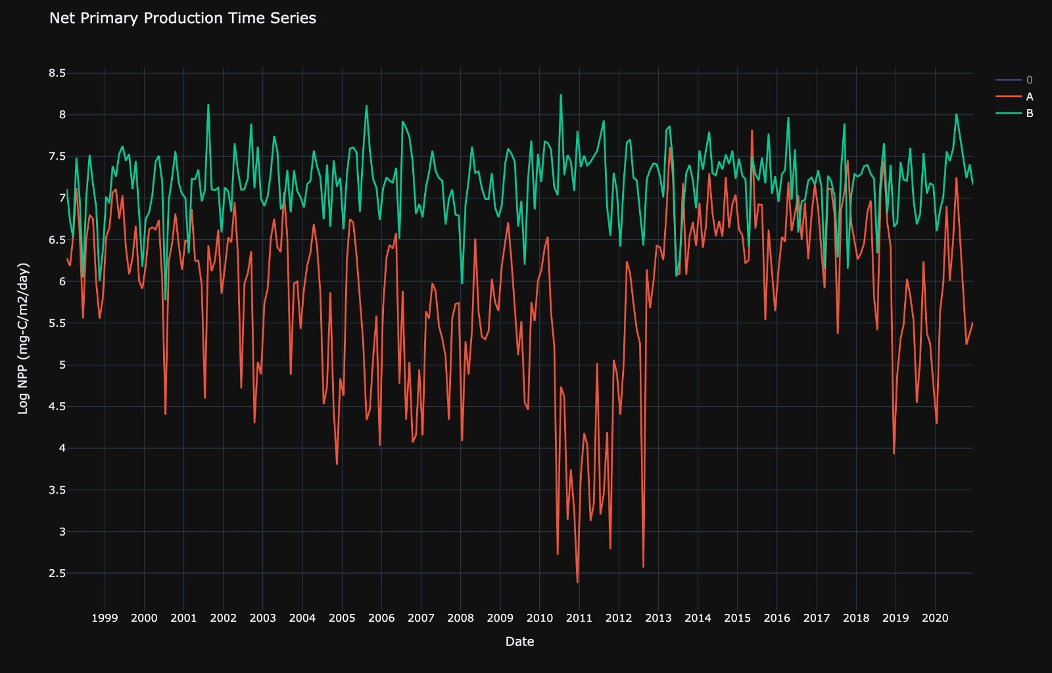
Net primary production is inversely related to chl-a.
What could the drop in the NPP levels during 2010-2012 followed by expansion indicate?
Could there be a change in phytoplankton type that causes such a behaviour or is it the same phytoplankton experiencing rapid change in population due to algal toxins?
Perhaps a combination of both!?
Notes:
There are many different types of phytoplankton, and they vary in their nutrient requirements, light requirements, and NPP. Some of the major groups of phytoplankton include diatoms, dinoflagellates, coccolithophores, and cyanobacteria.
Diatoms are a type of phytoplankton that require high levels of silicate and other nutrients to build their cell walls. They are often found in colder, nutrient-rich waters and can dominate in areas with strong upwelling. They require high levels of both nitrogen and silicate, as well as moderate light levels.
Dinoflagellates are another common type of phytoplankton that can be mixotrophic (able to obtain energy from both photosynthesis and consuming other organisms) and are often found in warmer, nutrient-poor waters.
Coccolithophores are a type of phytoplankton that build their cell walls out of calcium carbonate plates and are found in both warm and cold waters.
Cyanobacteria, also known as blue-green algae, are a group of bacteria that can perform photosynthesis and are often found in freshwater and brackish water environments. These can grow well in low-nutrient, high-light environments

Slide 10
Conclusion
Challenges in diagnosing the plankton health in Mauritania coast
Reason - Negative correlation between NPP and Chlorophyll
Significant findings
Chlorophyll alpha signal
peaks in August and lows in January.
20-year cycle - plausible cyclic Atlantic variation
Salinity and temperature analysis
Indirect horizontal wind correlation with chl-a via temperatures
Recommendation
Further studies on the diversity of phytoplankton species.
Notes:
To conclude, it is hard to diagnose the plankton health in Mauritania coast because there is a negative correlation between NPP and chlorophyll.
But, our team figured out some significant patterns of key factors which may be beneficial to further studies.
Chlorophyll alpha signal has peaks in Aug, lows in Jan.
Besides, there is plausible cyclic Atlantic variation during 20-year cycle.
An indirect horizonal wind correlation with chlorophyll-alpha via temperature is found in our salinity and temperature analysis.
Our team suggest further studies on the diversity of phytoplankton species is necessary to gain a full picture of phytoplankton health in Mauritania coast.

Slide 11
Reference
Gibbs, D., 1984. The politics of economic development: the case of the Mauritanian fishing industry. African Studies Review, 27(4), pp.79-93.
Käse, L. and Geuer, J.K., 2018. Phytoplankton responses to marine climate change–an introduction. In YOUMARES 8–Oceans Across Boundaries: Learning from each other: Proceedings of the 2017 conference for YOUng MARine RESearchers in Kiel, Germany (pp. 55-71). Springer International Publishing.
Petrovskii, S., Sekerci, Y. and Venturino, E., 2017. Regime shifts and ecological catastrophes in a model of plankton-oxygen dynamics under the climate change. Journal of theoretical biology, 424, pp.91-109.
Petrovskii, S., Sekerci, Y. and Venturino, E., 2017. Regime shifts and ecological catastrophes in a model of plankton-oxygen dynamics under the climate change. Journal of theoretical biology, 424, pp.91-109.
Romero, O.E., Ramondenc, S. and Fischer, G., 2021. A 2-decade (1988–2009) record of diatom fluxes in the Mauritanian coastal upwelling: impact of low-frequency forcing and a two-step shift in the species composition. Biogeosciences, 18(5), pp.1873-1891.
Sigman, D.M. and Hain, M.P., 2012. The biological productivity of the ocean. Nature Education Knowledge, 3(10), p.21

Slide 12

Thank You !
Planktonic Pirates Team

